Slide 1
Tata Data Visualization: Empowering Business with Effective Insights
Prepared by:
Aayush Jangid

Slide 2
Table of Content
Introduction
Thought Process
Insights
Recommendations

Slide 3

Introduction
Hello, I am Aayush Jangid and I welcome you in this presentation. I will take you through our company’s sales performance for the years 2010 and 2011.
I appreciate the opportunity you gave me to dive into this data to gain insightful information about the Sale’s performance.
Thank you also for the questions you asked since they provided a general direction for the kind of insights you are looking to get from this analysis.

Slide 4
Thought Process
I assure you that I took all the necessary steps to ensure that this analysis is accurate and correct.
I cleaned up the data you provided by removing all the negative values in the Unit Price and Quantity columns and also filtered the data as required for all the visualizations.

Slide 5
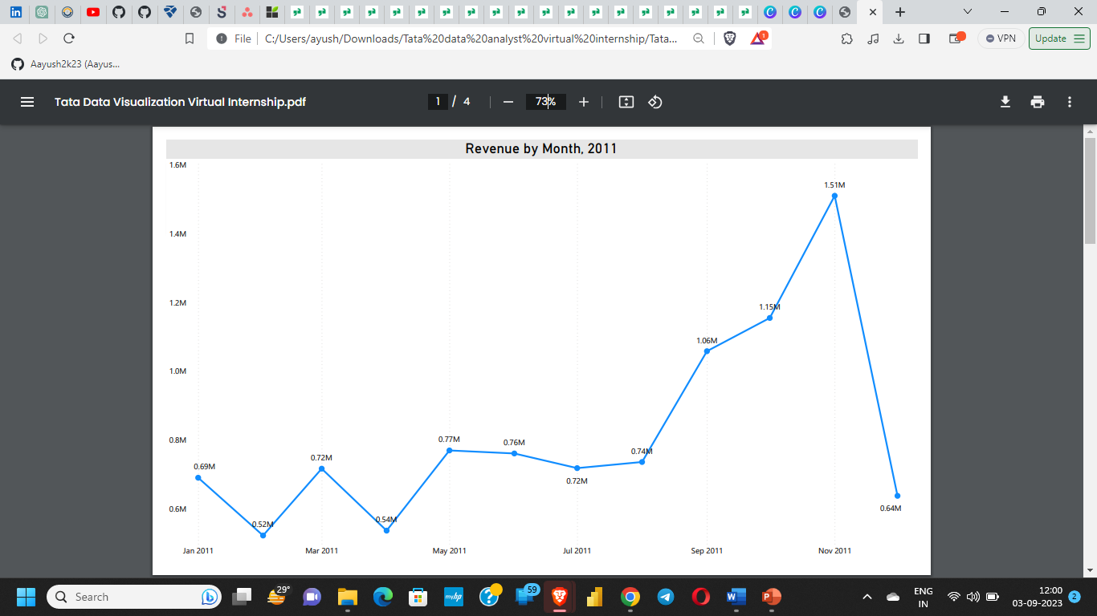
The first 8 months had monthly average revenue of approx. $6,83,000, last 4 months had approx. $10,90,000 with overall average of approx. $8,18,000 per month.
We had a significant increase in revenue from September with the revenue peaking at $15,10,000 in November and an increase of 104% in revenue from August to November.
The revenue trend from August to December demonstrates how seasonality affects retail store sales.

Slide 6
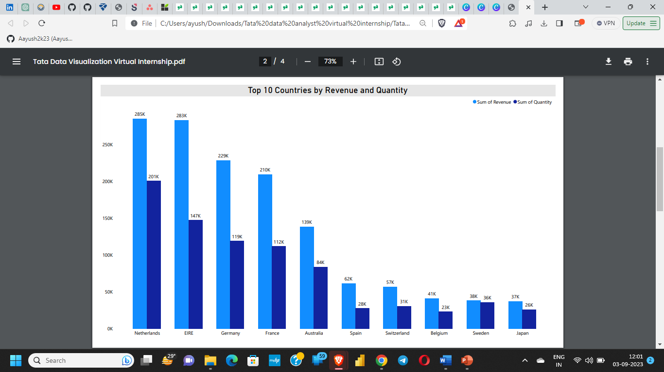
This chart represents the top 10 countries in revenue and the quantities bought in these countries except The United Kingdom.
According to the data, sales of units and income are quite high in nations like the Netherlands, Ireland, Germany, and France.
These countries represent regions with the highest potential to generate more revenue that management needs to focus more on in terms of marketing strategies.

Slide 7
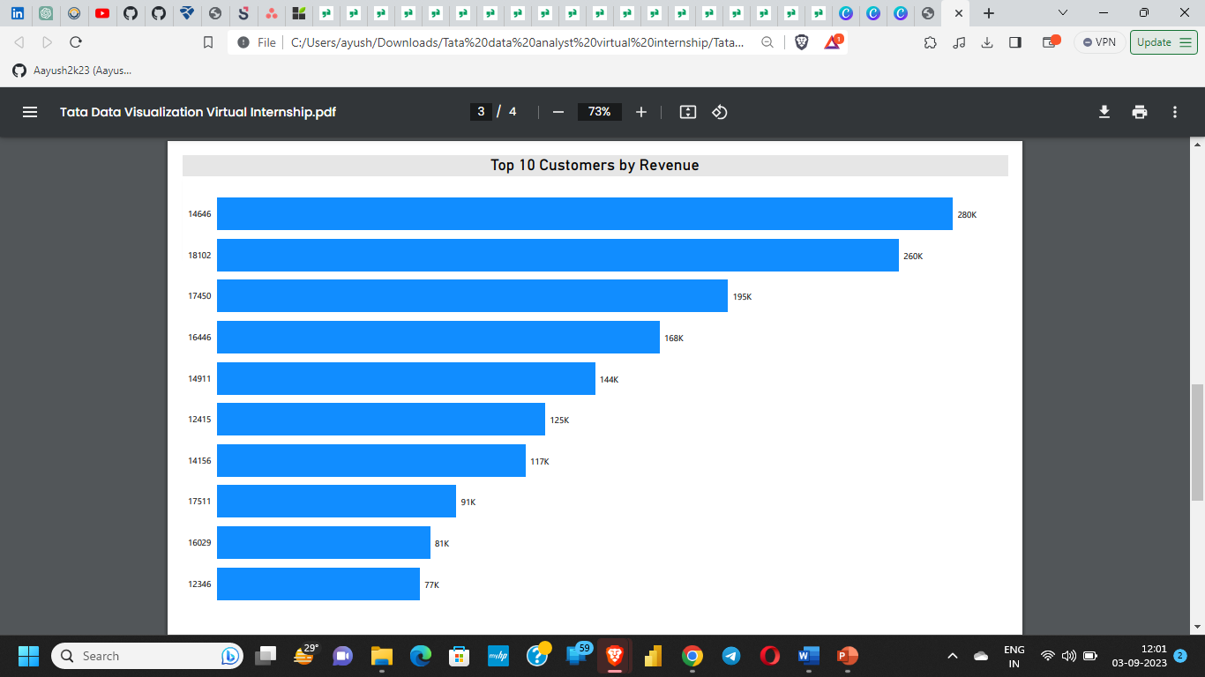
The chart shows that the top 10 customers in terms of revenue generated. Customer who has Customer ID 14646 contributed to the most revenue.
The average revenue generated by the top 10 customers is $1,53,800.
The company can aim to strengthen the relationship with these customers to increase customer loyalty and retention, and ultimately drive more sales and revenue for the company. We can also give some special offers and discounts to top customers.

Slide 8
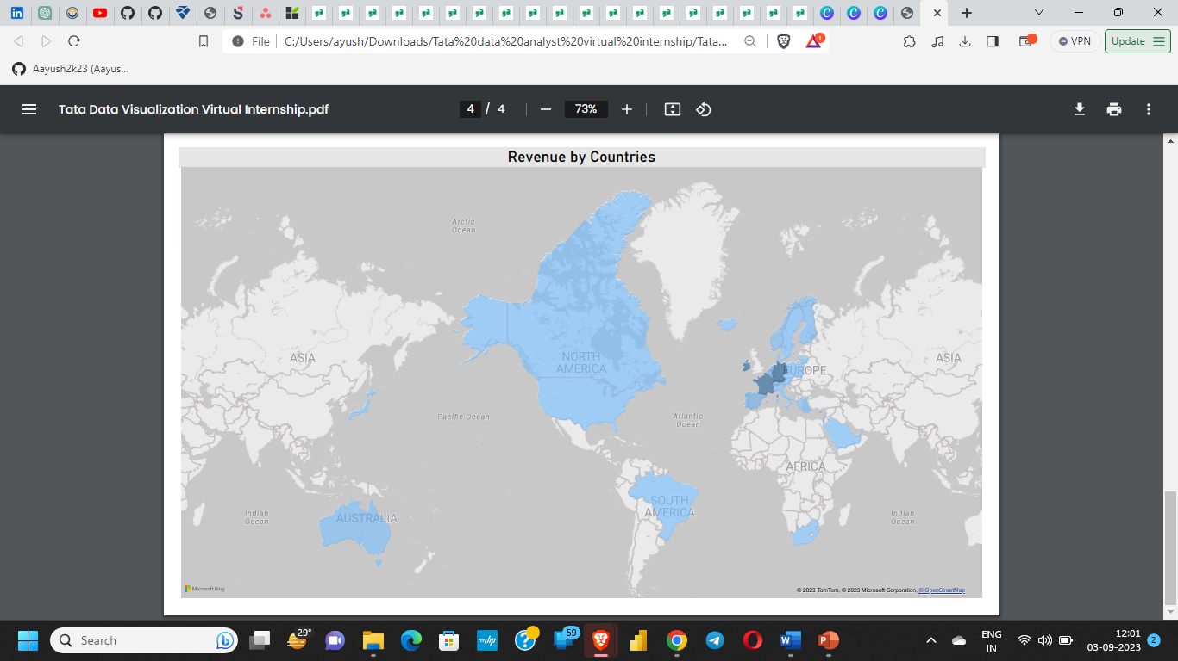
The Map Graph represent the countries which have produced revenue for our company.
Apart from the UK, it is clear that nations like the Netherlands, Ireland, Germany, France, and Australia generate large profits
The map also reveals that the majority of sales occur only in the European zone, with only a small number in the American region
Along with Russia, there is no market for the items in Africa or Asia. Sales revenues and profitability might increase with the implementation of a fresh strategy focused on these areas.

Slide 9
Recommendations
The company should come up with strategies that aim at stocking and advertising seasonal products to maximize sales when the demand for these goods goes up.
The company should do a deeper analysis of products that are usually in high demand during low-sales months to come up with strategies for marketing these products.
A deeper dive into the type of products and the revenue generated from these products for each region would be key in guiding region-specific marketing strategies.
The company should consider incentivizing top revenue-generating customers to strengthen the relationship with these customers.
The European Market has more potential for growth and the company should aim at strategies that will increase its market positioning in the region.

Slide 10
THANK YOU

